Slide 1
Inheritance & Polymorphism
BACS2023
Object-Oriented Programming
Chapter 6 – Part 1

Slide 2
A scenario (1)
Suppose you have created the following 3 classes for an application:
Circle |  | Rectangle |  | Triangle
-color: String -radius: double |  | -color: String -length: double -width: double |  | -color: String -base: double -height: double
+getColor(): String +setColor(color:String): void +getRadius(): double +setRadius(radius: double): void +getArea(): double |  | +getColor(): String +setColor(color:String): void +getLength(): double +setLength(length: double): void +getWidth(): double +setWidth(width: double): void +getArea(): double |  | +getColor(): String +setColor(color:String): void +getBase(): double +setBase(base: double): void +getHeight(): double +setHeight(height: double): void +getArea(): double
If the client now wants to record the date created of each Circle, Rectangle and Triangle object, what would you do?
A few weeks later, the client informs you that he also wants the fill status of each Circle, Rectangle and Triangle object to be recorded …
What would you do ?

Slide 3
A scenario (2)
Circle |  | Rectangle |  | Triangle
-color: String -radius: double |  | -color: String -length: double -width: double |  | -color: String -base: double -height: double
+getColor(): String +setColor(color:String): void +getRadius(): double +setRadius(radius: double): void +getArea(): double |  | +getColor(): String +setColor(color:String): void +getLength(): double +setLength(length: double): void +getWidth(): double +setWidth(width: double): void +getArea(): double |  | +getColor(): String +setColor(color:String): void +getBase(): double +setBase(base: double): void +getHeight(): double +setHeight(height: double): void +getArea(): double
Notice the common properties and behaviors in the 3 classes.
What is the best way to design these classes to avoid redundancy?
Could these common properties and behaviors be extracted and placed in a more general class?
If so, you would only need to make changes to this general class.

Slide 4
Learning Outcomes
At the end of this chapter, you should be able to
Develop a subclass from a superclass through inheritance.
Invoke the superclass’s constructors using the super keyword.
Describe constructor chaining.
Override methods in the subclass.
Override the useful methods toString() and equals(Object) from the Object class. Distinguish differences between overriding and overloading.
Notes:
4

Slide 5
1. Introduction to Inheritance (1)
Inheritance is an important and powerful feature for reusing software.
In fact, every class you define in Java is inherited from an existing class, either explicitly or implicitly.
The classes that you created so far were all extended implicitly from the java.lang.Object class.

Slide 6
Introduction to Inheritance (2)
Inheritance is one of the three foundation principles of OOP because it allows the creation of hierarchical classifications.
Using inheritance, you can create a general class that defines traits common to a set of related items.
This class can then be inherited by other, more specific classes, each adding properties and behaviors that are unique to them.
Bank account
Saving account
Checking account
Senior citizen account
Children account

Slide 7
2. Superclasses and Subclasses (1)
C1
Bank account
Superclass
Inherits
C2
Saving account
Checking account
Subclass
If a class C2 is derived or inherited from another class called C1, then C2 is called a subclass, and C1 is called a superclass.

Slide 8
Superclasses and Subclasses (2)
A subclass
inherits all the data members and methods of its superclass.
Defines its own (additional) new data and methods, i.e. they usually have more functionality than their superclasses.
Bank account
Saving account
Checking account
Term | Aliases
Subclass | Child Class, Extended Class or Derived Class
Superclass | Parent Class, Base Class

Slide 9
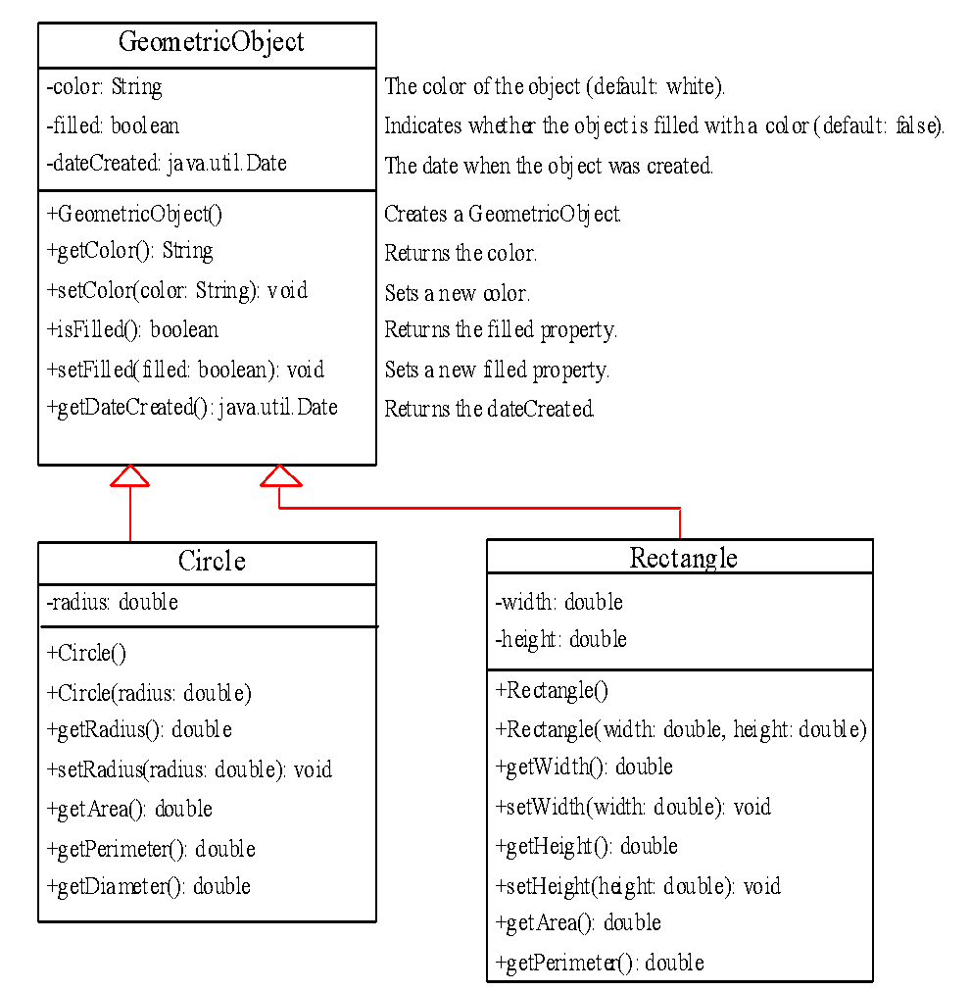
Refer to the following classes under folder Demo 6.1:
GeometricObject
Circle
Rectangle
TestCircleRectangle

Slide 10
Superclasses and Subclasses (3)
Java supports inheritance by using the extends keyword.
Thus, the subclass adds to (extends) the superclass. This is an important and powerful concept in object-oriented programming.
Example:
class Circle extends GeometricObject{
. . .
}

Slide 11
public class Rectangle extends GeometricObj { private double width; private double height; …….. public double getArea() { return width * height; } }
import java.util.Date;
public class GeometricObj {
private String color = "white";
private Date dateCreated;
public GeometricObj()
{ dateCreated = new Date(); }
public String getColor()
{ return color; }
public void setColor(String color)
{ this.color = color; }
…..
}
public class TestCircleRectangle {
public static void main(String[] args) {
Circle c = new Circle(1);
System.out.println(“Area = "+ c.getArea());
System.out.println(“Colour is “+ c.getColor());
Rectangle r = new Rectangle(2,4);
System.out.println(“Area = "+ r.getArea());
r.setColor("blue");
System.out.println(“Colour is " + r.getColor());
}
}
public class Circle extends GeometricObj {
private double radius;
public Circle() { }
public Circle(double radius)
{ this.radius = radius; }
…….
public double getArea()
{ return radius * radius * Math.PI; }
…….
}
9-11
Notes:
11

Slide 12
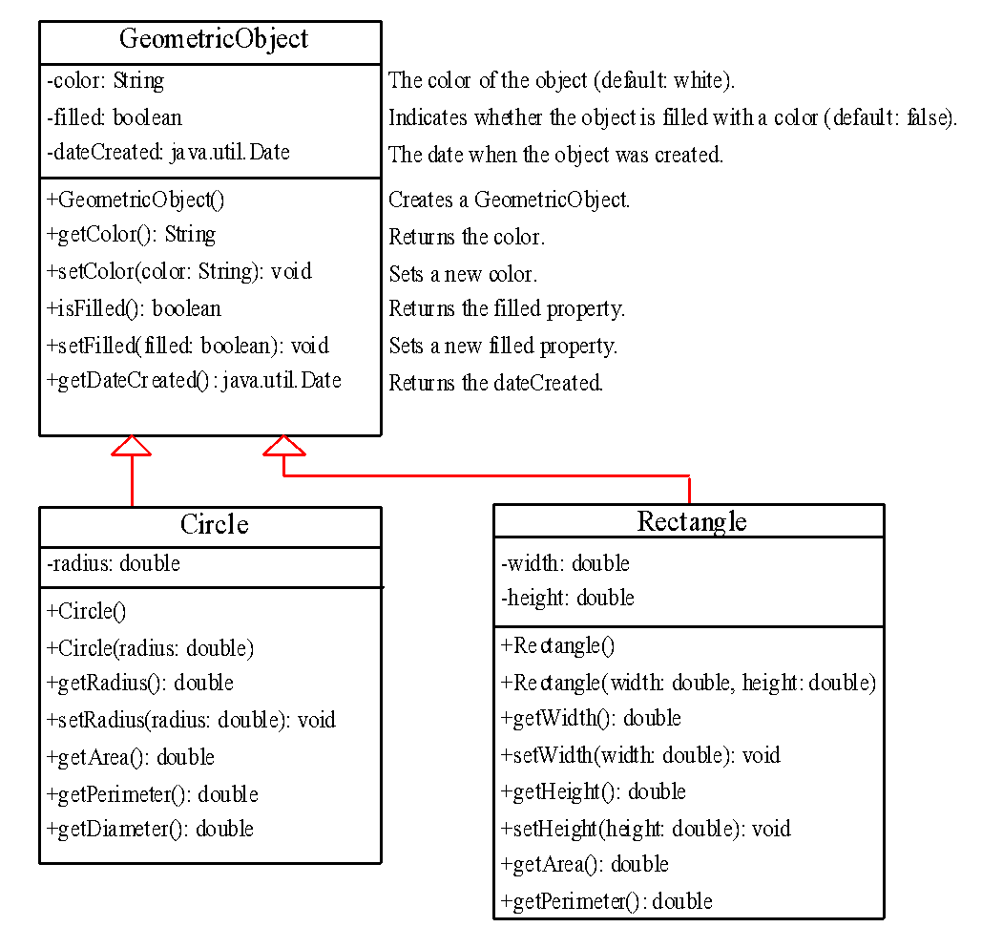
Superclasses and Subclasses (4)
The Circle and Rectangle class will inherit from the GeometricObject the data fields
color
filled
dateCreated
and the methods
getColor()
setColor()
isFilled()
setFilled()
getDateCreated()

Slide 13
Superclasses and Subclasses (5)
Note, however, that private data fields and methods in a superclass are not accessible in its subclasses.
To refer to the data fields color, dateCreated , and filled , use the get and set methods .
The inherited public methods may be invoked by any of the subclasses’ instances.
Thus, as GeometricObject’s getColor(), setColor(), getDateCreated(), isFilled() and setFilled() methods are declared as public, these methods may be invoked by any Circle or Rectangle objects.

Slide 14
3. Rationale for using inheritance (1)
Reuse
Inheritance allows you to reuse the code from a previous programming project without starting from scratch to reinvent the code.
E.g., if we want to have a class called Cylinder to store the radius and length of a cylinder, we can derive the Cylinder class from the Circle class.
Although the new class might be slightly different from the old, inheritance allows you to build on what was done previously.
GeometricObject
Circle
Rectangle
Cylinder

Slide 15
Rationale for using inheritance (2)
Class hierarchy
Inheritance allows you to build a hierarchy among classes.
Example:-
A general GeometricObject class is used to define general variables of a geometric object (e.g. object color) and methods (e.g. setColor()) that are common to all geometric objects.
The Circle class and Rectangle class which represents specific geometric objects can both be derived from the GeometricObject class
GeometricObject
Circle
Rectangle

Slide 16
Note
A subclass is not a subset of its superclass.
Rather, a subclass is an extension of its superclass as it contains more information and functions than its superclass.
Inheritance is used to model the is-a relationship.
Hence, a subclass and its superclass must have the is-a relationship.
In Java, multiple inheritance is not allowed - only single inheritance is allowed.
GeometricObject
Circle
Rectangle
Superclass1
Superclass 2
subclass

Slide 17
4. Superclass Constructors
Superclass’ constructors are not inherited by its subclasses.
The superclasses and subclasses have their own constructors (whether default or explicit).
The constructor for the superclass constructs the superclass portion of the object whereas the constructors for the subclass constructs the subclass part.

Slide 18
Invoking superclass’s constructor
A superclass’s constructors will be invoked in its subclasses’ constructors
They are invoked explicitly or implicitly.
Explicitly using the super keyword.
If the keyword super is not explicitly used, the superclass's no-arg constructor is automatically invoked.
public class Circle extends GeometricObject {
private double radius;
public Circle(String c, double r){
super(c);
radius = r;
}
public Circle(){
radius = 1.0;
}
import java.util.Date;
public class GeometricObject {
private String color;
private Date dateCreated;
public GeometricObject(){
this(“Blue”);
}
public GeometricObject(String c) {
color = c;
dateCreated = new Date();
}
….
}

Slide 19
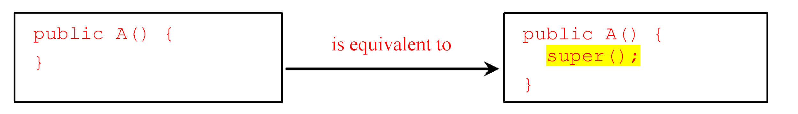
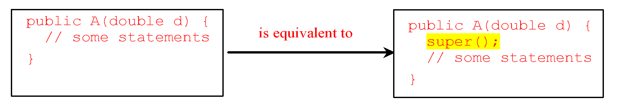
Superclass’s Constructor Is Always Invoked
If none of the constructor is invoked explicitly, the compiler puts super() as the first statement in the constructor.

Slide 20
Using the Keyword super
The keyword super refers to the superclass of the class in which super appears.
This keyword can be used in two ways:
To call a superclass constructor
To call a superclass method

Slide 21

Calling a Superclass’ Constructor
Syntax to call a superclass constructor:
super(arguments);
The statement super(arguments)must always be the first statement executed inside a subclass constructor.
Caution
You must use the keyword super to call the superclass constructor.
Invoking a superclass constructor’s name in a subclass causes a syntax error.

Slide 22
5. Constructor Chaining
public class Faculty extends Employee {
public static void main(String[] args) {
new Faculty();
}
public Faculty() {
System.out.println("(4) Faculty's no-arg constructor is invoked");
}
}
class Employee extends Person {
public Employee() {
this("(2) Invoke Employee’s overloaded constructor");
System.out.println("(3) Employee's no-arg constructor is invoked");
}
public Employee(String s) {
System.out.println(s);
}
}
class Person {
public Person() {
System.out.println("(1) Person's no-arg constructor is invoked");
}
}
Person
Employee
Faculty
Constructing an instance of a class invokes all the superclasses’ constructors along the inheritance chain. This is called constructor chaining.

Slide 23
Trace Execution
animation
public class Faculty extends Employee {
public static void main(String[] args) {
new Faculty();
}
public Faculty() {
System.out.println("(4) Faculty's no-arg constructor is invoked");
}
}
class Employee extends Person {
public Employee() {
this("(2) Invoke Employee’s overloaded constructor");
System.out.println("(3) Employee's no-arg constructor is invoked");
}
public Employee(String s) {
System.out.println(s);
}
}
class Person {
public Person() {
System.out.println("(1) Person's no-arg constructor is invoked");
}
}
1. Start from the main method

Slide 24
Trace Execution
animation
public class Faculty extends Employee {
public static void main(String[] args) {
new Faculty();
}
public Faculty() {
System.out.println("(4) Faculty's no-arg constructor is invoked");
}
}
class Employee extends Person {
public Employee() {
this("(2) Invoke Employee’s overloaded constructor");
System.out.println("(3) Employee's no-arg constructor is invoked");
}
public Employee(String s) {
System.out.println(s);
}
}
class Person {
public Person() {
System.out.println("(1) Person's no-arg constructor is invoked");
}
}
2. Invoke Faculty constructor

Slide 25
Trace Execution
animation
public class Faculty extends Employee {
public static void main(String[] args) {
new Faculty();
}
public Faculty() {
System.out.println("(4) Faculty's no-arg constructor is invoked");
}
}
class Employee extends Person {
public Employee() {
this("(2) Invoke Employee’s overloaded constructor");
System.out.println("(3) Employee's no-arg constructor is invoked");
}
public Employee(String s) {
System.out.println(s);
}
}
class Person {
public Person() {
System.out.println("(1) Person's no-arg constructor is invoked");
}
}
3. Invoke Employee’s no-arg constructor

Slide 26
Trace Execution
animation
public class Faculty extends Employee {
public static void main(String[] args) {
new Faculty();
}
public Faculty() {
System.out.println("(4) Faculty's no-arg constructor is invoked");
}
}
class Employee extends Person {
public Employee() {
this("(2) Invoke Employee’s overloaded constructor");
System.out.println("(3) Employee's no-arg constructor is invoked");
}
public Employee(String s) {
System.out.println(s);
}
}
class Person {
public Person() {
System.out.println("(1) Person's no-arg constructor is invoked");
}
}
4. Invoke Employee(String) constructor

Slide 27
Trace Execution
animation
public class Faculty extends Employee {
public static void main(String[] args) {
new Faculty();
}
public Faculty() {
System.out.println("(4) Faculty's no-arg constructor is invoked");
}
}
class Employee extends Person {
public Employee() {
this("(2) Invoke Employee’s overloaded constructor");
System.out.println("(3) Employee's no-arg constructor is invoked");
}
public Employee(String s) {
System.out.println(s);
}
}
class Person {
public Person() {
System.out.println("(1) Person's no-arg constructor is invoked");
}
}
5. Invoke Person() constructor

Slide 28
Trace Execution
animation
public class Faculty extends Employee {
public static void main(String[] args) {
new Faculty();
}
public Faculty() {
System.out.println("(4) Faculty's no-arg constructor is invoked");
}
}
class Employee extends Person {
public Employee() {
this("(2) Invoke Employee’s overloaded constructor");
System.out.println("(3) Employee's no-arg constructor is invoked");
}
public Employee(String s) {
System.out.println(s);
}
}
class Person {
public Person() {
System.out.println("(1) Person's no-arg constructor is invoked");
}
}
6. Execute println

Slide 29
Trace Execution
animation
public class Faculty extends Employee {
public static void main(String[] args) {
new Faculty();
}
public Faculty() {
System.out.println("(4) Faculty's no-arg constructor is invoked");
}
}
class Employee extends Person {
public Employee() {
this("(2) Invoke Employee’s overloaded constructor");
System.out.println("(3) Employee's no-arg constructor is invoked");
}
public Employee(String s) {
System.out.println(s);
}
}
class Person {
public Person() {
System.out.println("(1) Person's no-arg constructor is invoked");
}
}
7. Execute println

Slide 30
Trace Execution
animation
public class Faculty extends Employee {
public static void main(String[] args) {
new Faculty();
}
public Faculty() {
System.out.println("(4) Faculty's no-arg constructor is invoked");
}
}
class Employee extends Person {
public Employee() {
this("(2) Invoke Employee’s overloaded constructor");
System.out.println("(3) Employee's no-arg constructor is invoked");
}
public Employee(String s) {
System.out.println(s);
}
}
class Person {
public Person() {
System.out.println("(1) Person's no-arg constructor is invoked");
}
}
8. Execute println

Slide 31
Trace Execution
animation
public class Faculty extends Employee {
public static void main(String[] args) {
new Faculty();
}
public Faculty() {
System.out.println("(4) Faculty's no-arg constructor is invoked");
}
}
class Employee extends Person {
public Employee() {
this("(2) Invoke Employee’s overloaded constructor");
System.out.println("(3) Employee's no-arg constructor is invoked");
}
public Employee(String s) {
System.out.println(s);
}
}
class Person {
public Person() {
System.out.println("(1) Person's no-arg constructor is invoked");
}
}
9. Execute println

Slide 32
Constructor Chaining Example
Refer to the following classes under folder Demo 6.2:
GeometricObject
Circle
Rectangle
TestCircleRectangle

Slide 33
Example on the Impact of a Superclass without no-arg Constructor
Find out the errors in the program:
public class Apple extends Fruit {
}
class Fruit {
public Fruit(String name) {
System.out.println("Fruit's constructor is invoked");
}
}
Design Guide:
It is better to provide a no-arg constructor for every class to ensure the class is easy to extend and to avoid errors.

Slide 34
6. Overriding Methods in the Superclass (1)
A subclass inherits methods from a superclass. A subclass extends properties and methods from the superclass.
Sometimes it is necessary for the subclass to modify the implementation of a method defined in the superclass. This is referred to as method overriding.

Slide 35
Overriding Methods in the Superclass (2)
public class GeometricObject {
// Other methods are omitted
public void display() {
System.out.println("\nColor: " + color + "\nFilled: " +
filled + "\nDate created: " + dateCreated);
}
}
public class Circle extends GeometricObject {
// Other methods are omitted
/** Override the display method defined in GeometricObject */
public void display() {
System.out.println("\nColor: " + getColor() + "\nFilled: " +
isFilled() + "\nDate created: " + getDateCreated() +
"\nRadius: " + radius);
}
}

Slide 36
Calling a Superclass’ Method (1)
To invoke a superclass method from its subclass, use the keyword super as follows:
super.method(arguments);
super acts somewhat like this, except that it always refers to the superclass of the subclass in which it is used.

Slide 37
public class GeometricObject {
// Other methods are omitted
public void display() {
System.out.println("\nColor: " + color + "\nFilled: " +
filled + "\nDate created: " + dateCreated);
}
}
public class Circle extends GeometricObject {
………………
public void display() {
System.out.println("\nColor: " + getColor() + "\nFilled: " +
isFilled() + "\nDate created: " + getDateCreated() +
"\nRadius: " + radius);
}
}
public class Circle extends GeometricObject {
……………………
public void display() {
super.display();
System.out.println(“Radius: " + radius);
}
}

Slide 38
Calling a Superclass’ Method (2)
Refer to the following classes in the Demo 6.3 folder to see how the superclass’s display() method is invoked in its subclasses:
GeometricObject
Circle
Rectangle
TestCircleRectangle

Slide 39
Calling a Superclass’ Method
public class DemoSuper{
public static void main(String [] args){
A x=new A();
x.p();
}
}
class A extends B{
public void p(){
…….
}
}
class B extends C{
….
}
class C{
public void p(){
System.out.println("In class C");
}
}
You can use super.p() to invoke the method p() defined in the superclass. Suppose A extends B and B extends C, and a method p() is defined in C.
Can you invoke super.super.p() from A?
Notes:
Can you invoke super.super.p() from A?
Answer: no

Slide 40
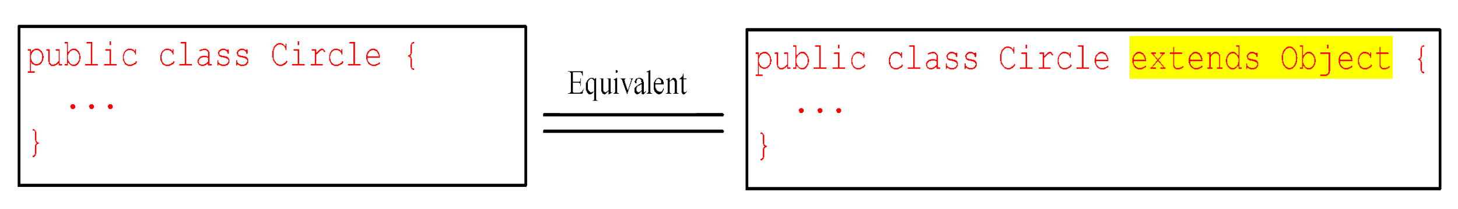
7. The Object Class and Its Methods
Every class in Java is descended from the java.lang.Object class.
If no inheritance is specified when a class is defined, the superclass of the class is Object.

Slide 41
7.1 The toString method (1)
The Object class has a method called toString() with the following method header:
public String toString()
The toString() method returns a string representation of the object.
The default implementation returns a string consisting of the object’s class name, the @ sign, and the object’s hashcode in hex. E.g., the code
Circle c = new Circle();
System.out.println(c.toString());
displays something like Circle@15037e5 . This message is not very helpful or informative.
Usually you should override the toString method so that it returns a meaningful string representation of the object.

Slide 42
Overriding the toString Method
public class GeometricObject {
// Other methods are omitted
/** Override the toString method defined in Object */
public String toString() {
return “Color is ” + color + "\nFilled is " + filled +
“\Date created is ” + dateCreated;
}
}
public class Circle extends GeometricObject {
// Other methods are omitted
/** Override the toString method defined in GeometricObject */
public String toString() {
return super.toString() + "\nradius is " + radius;
}
}

Slide 43
The toString method (2)
Using an object reference as the argument in the println() method will automatically invoke the object’s toString() method.
Thus,
is equivalent to invoking
System.out.println(circle)
System.out.println(circle.toString())

Slide 44
The toString method (3)
Refer to the following classes in the Demo 6.4 folder to see how the toString() method is overridden:
GeometricObject
Circle
Rectangle
TestCircleRectangle

Slide 45
7.2 The equals Method
The equals() method compares the contents of two objects.
The default implementation of the equals method in the Object class is as follows:
public boolean equals(Object obj) {
return (this == obj);
}
public boolean equals(Object o) {
if (o instanceof Circle) {
return radius == ((Circle)o).radius;
}
else
return false;
}
For example, the equals method is overridden in the Circle class.

Slide 46
NOTE
The == comparison operator is used for
comparing two primitive data type values or
determining whether two objects have the same references.
The equals method is intended to test whether two objects have the same contents, provided that the method is modified in the defining class of the objects.
The == operator is stronger than the equals method, in that the == operator checks whether the two reference variables refer to the same object.

Slide 47
8. Method Overriding (1)
In a class hierarchy, when a method in a subclass has the same return type and signature as a method in its superclass, the methods in the subclass is said to override the method in the superclass.
When an overridden method is called from within a subclass, it will always refer to the version of that method defined by the subclass.
GeometricObject
public String toString()
Circle
Rectangle

Slide 48
Method Overriding (2)
An instance method can be overridden only if it is accessible.
Thus a private method cannot be overridden, because it is not accessible outside its own class.
If a method defined in a subclass is private in its superclass, the two methods are completely unrelated.
public class GeometricObject {
private void display() {
System.out.println("\nColor: " + color + "\nFilled: " +
filled + "\nDate created: " + dateCreated);
}
}
public class Circle extends GeometricObject {
……………………
public void display() {
super.display(); //error
System.out.println(“Radius: " + radius);
}
}

Slide 49
Method Overriding (3)
Like an instance method, a static method can be inherited.
If a static method defined in the superclass is redefined in a subclass, the method defined in the superclass is hidden.
The hidden static methods can be invoked using the syntax SuperClassName.staticMethodName.

Slide 50
public class GeometricObject {
…..
private static int numObjects=0;
public static int getNumObjects(){
return numObjects++;
}
public static void displayObj(){
System.out.println(“Objects:”+ numObjects);
}
}
public class Circle extends GeometricObject {
…….
public String toString() {
return "\nObject = "+ getNumObjects() + super.toString ()+ "\nRadius: " + radius ;
}
public static void displayObj(){
GeometricObject.displayObj();
System.out.println(“Circles :”+getCircleObjCnt ());
}
}
public class TestCircleRectangle {
public static void main(String[] args) {
Circle c = new Circle(1);
c.displayObj();
System.out.println("\n\nNumber of objects created "+ c.getNumObjects());
}
50

Slide 51
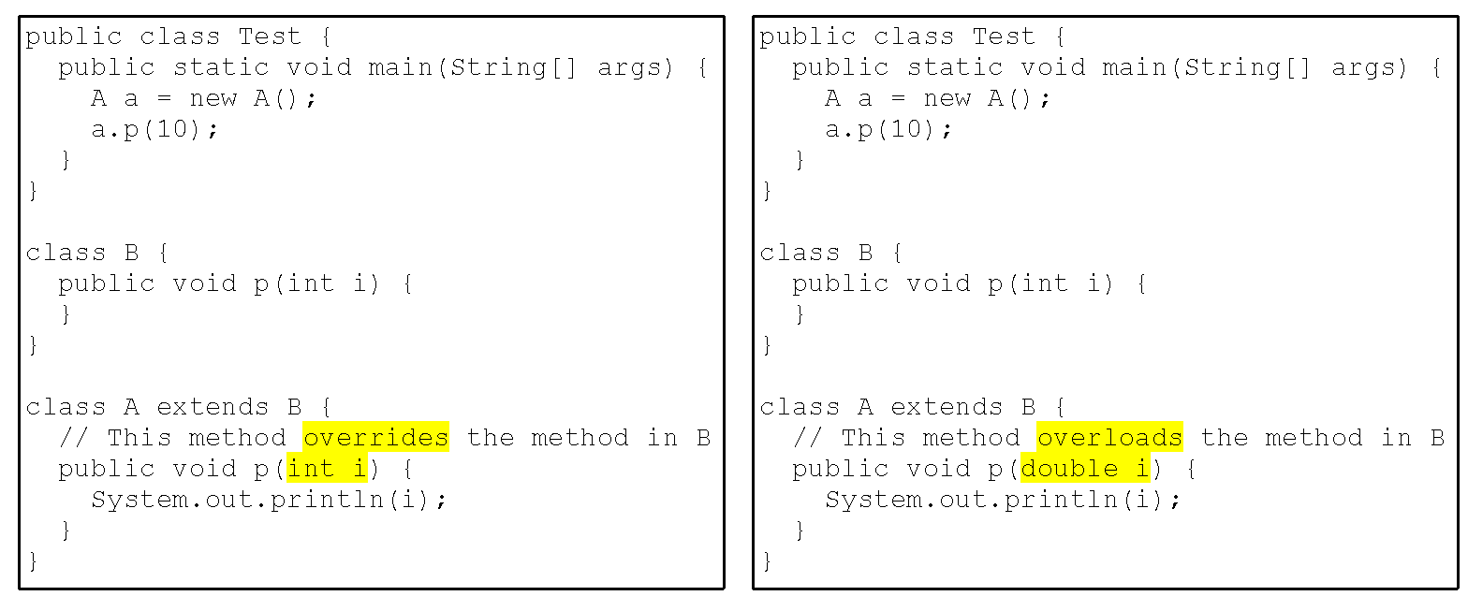
Method Overriding vs. Method Overloading
Method overriding occurs ONLY when the return types and signatures of the two methods are identical. If they are not, then the two methods are simply overloaded.
Notes:
When you run the Test class in (a), a.p(10) invokes the p(int i) method defined in class A, so the program displays 10.
When you run the Test class in (b), a.p(10) invokes the p(int i) method defined in class B, so nothing is printed.

Slide 52
To Do
Review the slides and source code for this chapter.
Read up the relevant portions of the recommended text.
Do the tutorial and complete the remaining practical questions for this chapter.
We shall selectively discuss them during class.
Notes:
52

